Slide 1



Unicorn Study
Companies: NoBroker & FalconX
Group Members:
Aryan Dhawan 2021023
Suyash Kumar 2021293
Aditya Yadav 2021374
This event has live translations.

Slide 2

Overview of NoBroker
India’s first Proptech Unicorn
Company Profile
Sector & Business Model
Founded in 2013 by Amit Agarwal, Akhli Gupta and Saurabh Garg. Focuses on eliminating brokers in real estate transactions.
Operating in proptech, connecting buyers, sellers, and tenants without brokers. Also provides rental payment services and home maintenance.
Total Funding: $430.9 million (Series E)
Valuation: $1 billion
FY23 Revenue: INR 609 crore (87% YoY growth)
Losses: INR 506 crore (FY23)
Users: 30 million; saving INR 130 crore/month in brokerage fees
Target: INR 1,000 crore revenue in FY24
Key Investors: Google, General Atlantic, Tiger Global
Key Financials

Slide 3
Market Opportunity of Proptech
Disrupting Real Estate through Proptech
Real Estate Market in India
Shift to Proptech
Long-term Growth Drivers
The indian real estate sector is expected to reach $1 trillion by 2030, driven by urbanisation and housing demand.
COVID-19 accelerated digital adoption in property transactions and home services.
Rising middle-class income and government policies favor digital real estate platforms.

Slide 4
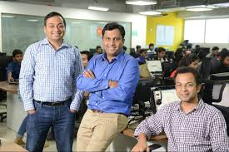
Founders & Management
Leadership and Strategic Backing
3 Founders
Founders & Key Personnel
The Founders Amit Agarwal, Akhil Gupta, and Saurabh Garg lead the company with a vision to eliminate brokers.
NoBroker's growth is supported by key leaders, including Ashish Shand (CFO) for financial strategy and Varun Kulkarni for digital marketing.
The flat hierarchy and cross-functional teams foster innovation and a strong customer-focused approach.

Slide 5
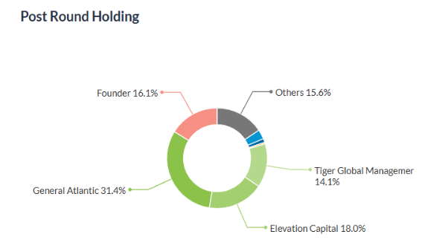


Investors in NoBroker
Leadership and strategic Backing
NoBroker has a total of 22 investors including 19 are institutional investors & Angels.
Prominent Investors: Google, General Atlantic, and Tiger Global are among the major backers.
Post-Money Valuation : $972M (As on March 02, 2023)

Slide 6
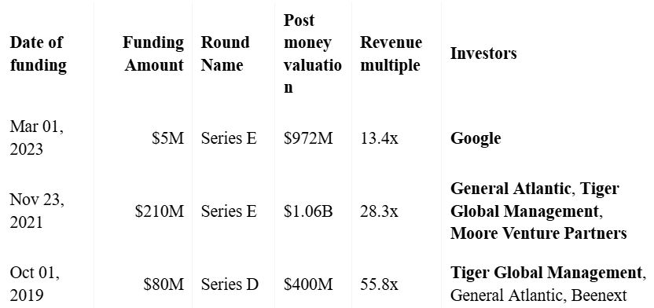
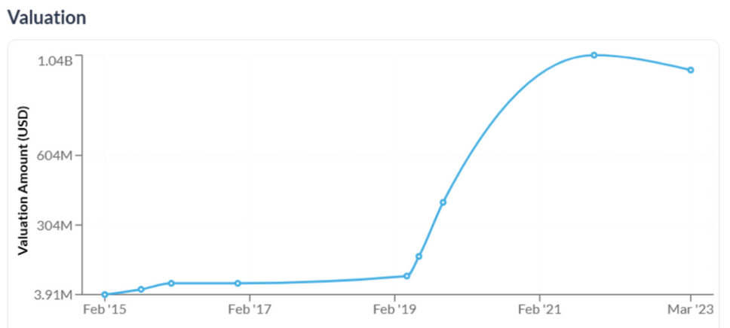
Funding Rounds
NoBroker has total 9 funding rounds
3 latest funding rounds:

Slide 7
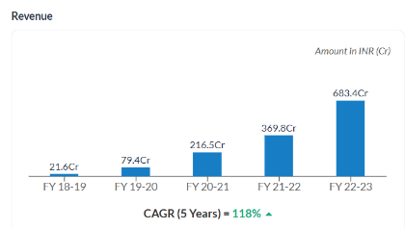
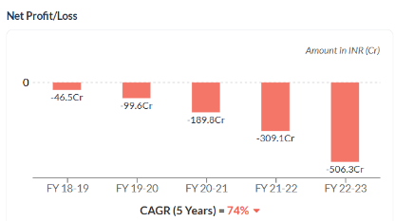
Financial Highlights of NoBroker
Revenue Growth: Revenue increased from INR 216 crore in FY20 - 21 to INR 683 crore in FY22 - 23 , a 68% rise.
Net losses have increased from INR 189.8 crore to INR 506.3 crore, highlighting financial challenges in achieving profitability despite revenue gains.
Expense Surge: Expenses rose from INR 679 crore to INR 1190 crore, leading to deeper losses of INR 506 crore in FY23.
Future Projections: Targeting INR 1,000 crore in FY24, focusing on cost management.

Slide 8


Overview of FalconX
Global Leader in Crypto Asset Trading
Company Profile
Sector & Business Model
Founded in 2018 by Raghu Yarlagadda and Prabhakar Reddy. Provides a crypto brokerage platform for institutional investors.
Operates in the digital assets space, offering OTC trading, lending, and prime brokerage services.
Total Funding: $500 million+
Valuation: $8 billion
Monthly Trading Volume: $10 billion+
Revenue Growth: Double-digit YoY growth
Profitability: High-margin institutional business model
Key Investors: Tiger Global, Accel, Lightspeed
Focus Areas: OTC trading, lending, derivatives, regulatory compliance
Key Financials

Slide 9
Market Opportunity of Crypto Trading Tech
Crypto Adoption and Institutional Trading
Crypto Adoption Trends
Institutional Market
Impact of Regulations
Global crypto market is projected to grow at a CAGR of 12.8% through 2030, driven by increasing institutional participation.
FaalconX targets institutional investors, offering OTC trading and prime brokerage solutions
Navigating evolving regulations will be key for sustainable growth

Slide 10
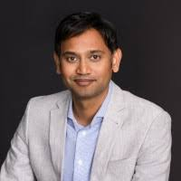
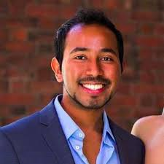
Founders & Management at FalconX
Visionary Leadership
Founders : Led by Raghu Yarlagadda and Prabhakar Reddy with a focus on building institutional crypto infrastructure.
Ivan Galli is the VP of Corporate Strategy & Finance, oversees financial planning and budgeting.
The organization is client-centric, innovation-driven, compliance-focused, and operates with a global perspective to meet diverse client needs in the evolving crypto market.
Raghu Yarlagadda
Prabhakar Reddy

Slide 11


Investors of FalconX
Key Investors:
GIC: Singapore's sovereign wealth fund known for investments across sectors globally.
B Capital: Co-founded by Facebook's Eduardo Saverin, it focuses on investments in fintech, health tech, and enterprise technologies.
Tiger Global: A major name in venture capital, investing heavily in both early-stage and growth-stage technology companies.

Slide 12
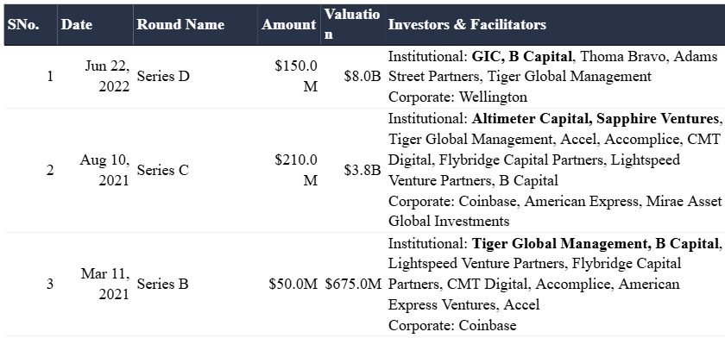
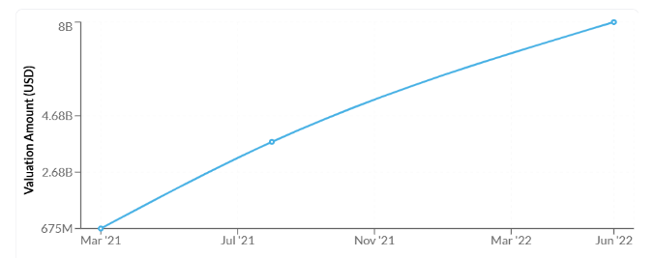
Funding Rounds
The platform has grown significantly, raising over $430 million to date, and its valuation reached $8 billion following its Series D funding round in 2022
3 latest funding rounds:

Slide 13
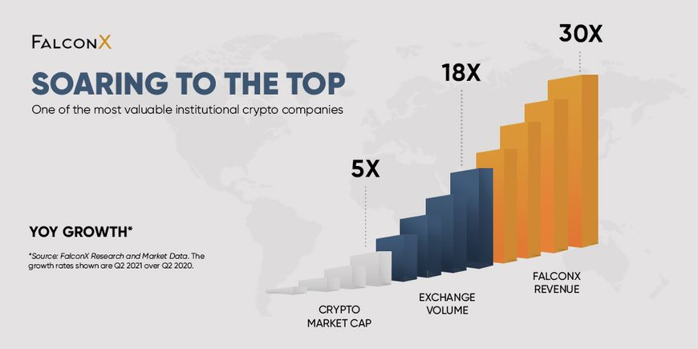
Financial Highlights of FalconX
Navigating Market Volatility
Valuation & Funding: Valuation surged from $3.75 billion (2021) to $8 billion (2022), supported by over $500M in funding.
Monthly Trading Volume: Processes over $10 billion in trades monthly, leveraging market volatility for higher returns.
Revenue & Margins: Double-digit revenue growth, with a focus on high-margin services like lending and derivatives.
Regulatory Adaption: Building compliance infrastructure to meet evolving global crypto regulations.
Global Expansion: Investing in Asia and Europe, adding new products like derivatives to capture institutional markets.

Slide 14
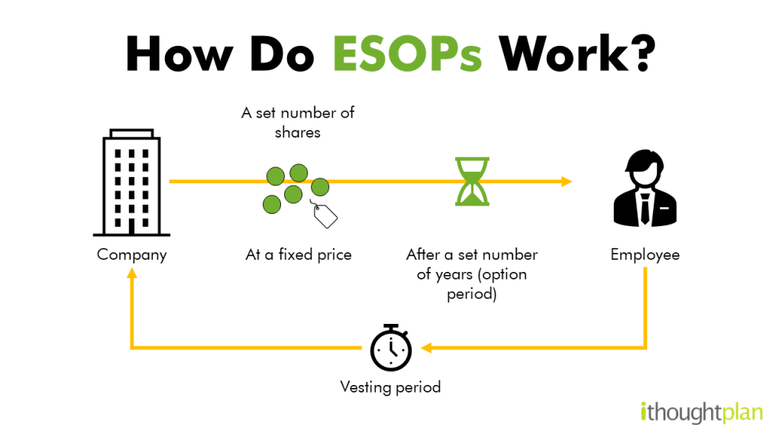
Indian Tax Provision & ESOPs
Incentves and Taxation for startups
Startup India Scheme: Eligible startups receive tax exemptions under Section 80-IAC for the first three years.
ESOP Taxation : Employees are taxed at two points-when options are exercised and when shares are sold.
Impact on Retention: Tax-efficient ESOP plans improve employee retention and motivation.

Slide 15
Conclusion & Key Learnings
Success Factors: Both companies leveraged innovative technology and strategic investements to disrupt traditional markets.
Challenges: NoBroker must control costs; FalconX faces evolving regulations.
Future Prospects: Both aim to scale further, NoBroker towards INR 1,000 crore revenue and FalconX by increasing transactions volumes.

Slide 16
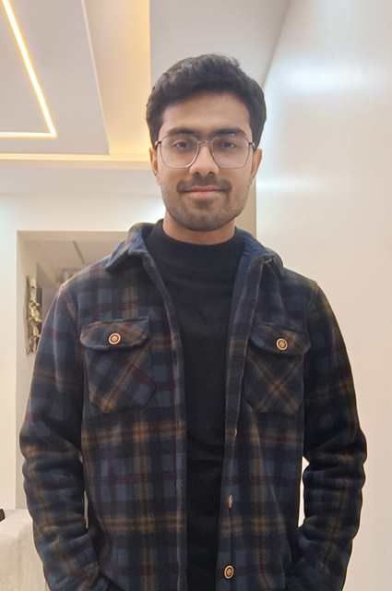
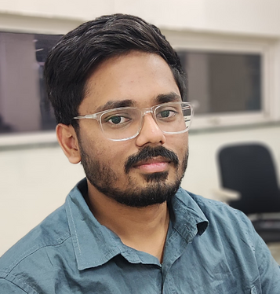


Suyash
Aryan
Aditya

